Slide 1


Slide 2
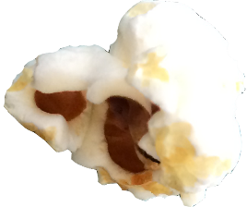
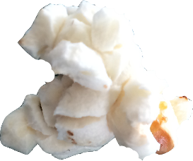
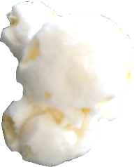
Do you know the OPTIMAL condition to POP CORNS ?

Slide 3
Jim’s favorite food is popcorn…
Motivation

Slide 4
Physics
Chemistry
Biology
Background Knowledge

Slide 5
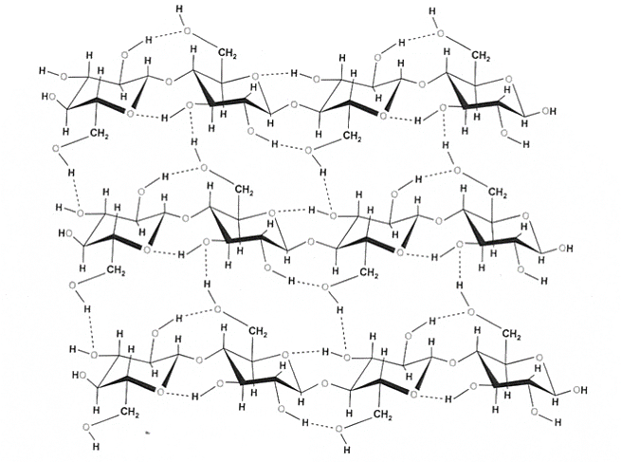

Slide 6
Physics
Chemistry
Biology
Background Knowledge

Slide 7
Material
Microwave oven
Bunsen burner
Frying pan
Forceps
Pipette
Popcorn kernel
Oil
Plastic container

Slide 8
Microwave oven
Independent variable | Special controlled variable
Time (min) | Power Level of Microwave oven – HL
2 3 4 5 6
Heat Energy (Power level) | Time of popping corn – 8 min
Low Level Middle Level High Level
Motivation

Slide 9
Frying Pan
Independent variable | Special controlled variable
Heat Energy (Distance between Bunsen burner and pan) (cm) | Time of popping corn – 10 min Amount of oil used – 3ml
5 10 12.5 15
Amount of oil used (ml) | Distance – 12.5 cm Time – 10 min
3 5

Slide 10
Other Controlled variables
Type of popcorn – brand, flavor
Container*:
plastic container,
same area of the base,
same volume.
Position in the microwave oven
How are corns positioned in the container
Number of corns in the container
Use the same microwave oven
Amount of fuel

Slide 11
Procedure
Ten packages from same brand of corns are bought
The corns are equally divided into several groups with 20 corns in each group.
Microwave oven: Each group is put into a plastic container. These groups are heated under different lengths of time or heat energy levels.
Frying pan: The pan is put on the holder. A Bunsen burner is used as a heat source. Different groups of corns are heated with different amount of oil or different distances away from the burner.
The number of corns that are not popped is counted.

Slide 12
Data collected
Energy level | Average | StdDev
Low | 0 | 0
Middle | 0.75 | 0.08124
High | 0.76 | 0.2000

Slide 13
Time (min) | Energy level | Average | StdDev
2 | HL | 0.47 | 0.14000
3 | HL | 0.50 | 0.05477
4 | HL | 0.86 | 0.05831
5 | HL | 0.49 | 0.04899
6 | HL | 0.58 | 0.02449

Slide 15
Distance (cm) | Oil (ml) | Average | StdDev
5 | 3 | 0.82 | 0.04000
10 | 3 | 0.44 | 0.09165
12.5 | 3 | 0.17 | 0.08718
15 | 3 | 0 | 0.00000

Slide 17
Oil (ml) | Distance (cm) | Average | StdDev
3 | 12.5 | 0.17 | 0.08718
5 | 12.5 | 0.13 | 0.05010

Slide 18
Optimum time for microwave oven to pop corns: 4 minutes
Same time, distance is inversely proportional to the success rate
Excessive use of oil will reduce the success rate
Use of high level power in microwave oven is the most efficient way in terms of time and energy cost
Conclusion

Slide 19
Evaluation of errors
There are some corns that are not going to pop anyway.
The temperature of the container.
The temperature of the microwave oven
Water remained in the container
The position of the corns.
Different containers are used because of accident.

Slide 20
How to improve ?
Use smaller and more endurable containers
Wait for the container and microwave oven to cool down before next experiment
Put an insulate shelter outside the system of pan to stabilize the flame and reduce energy loss to the air.
More repetitions on amount of oil
Smaller intervals between distances
Use more advanced equipment like electromagnetic oven.

Slide 22
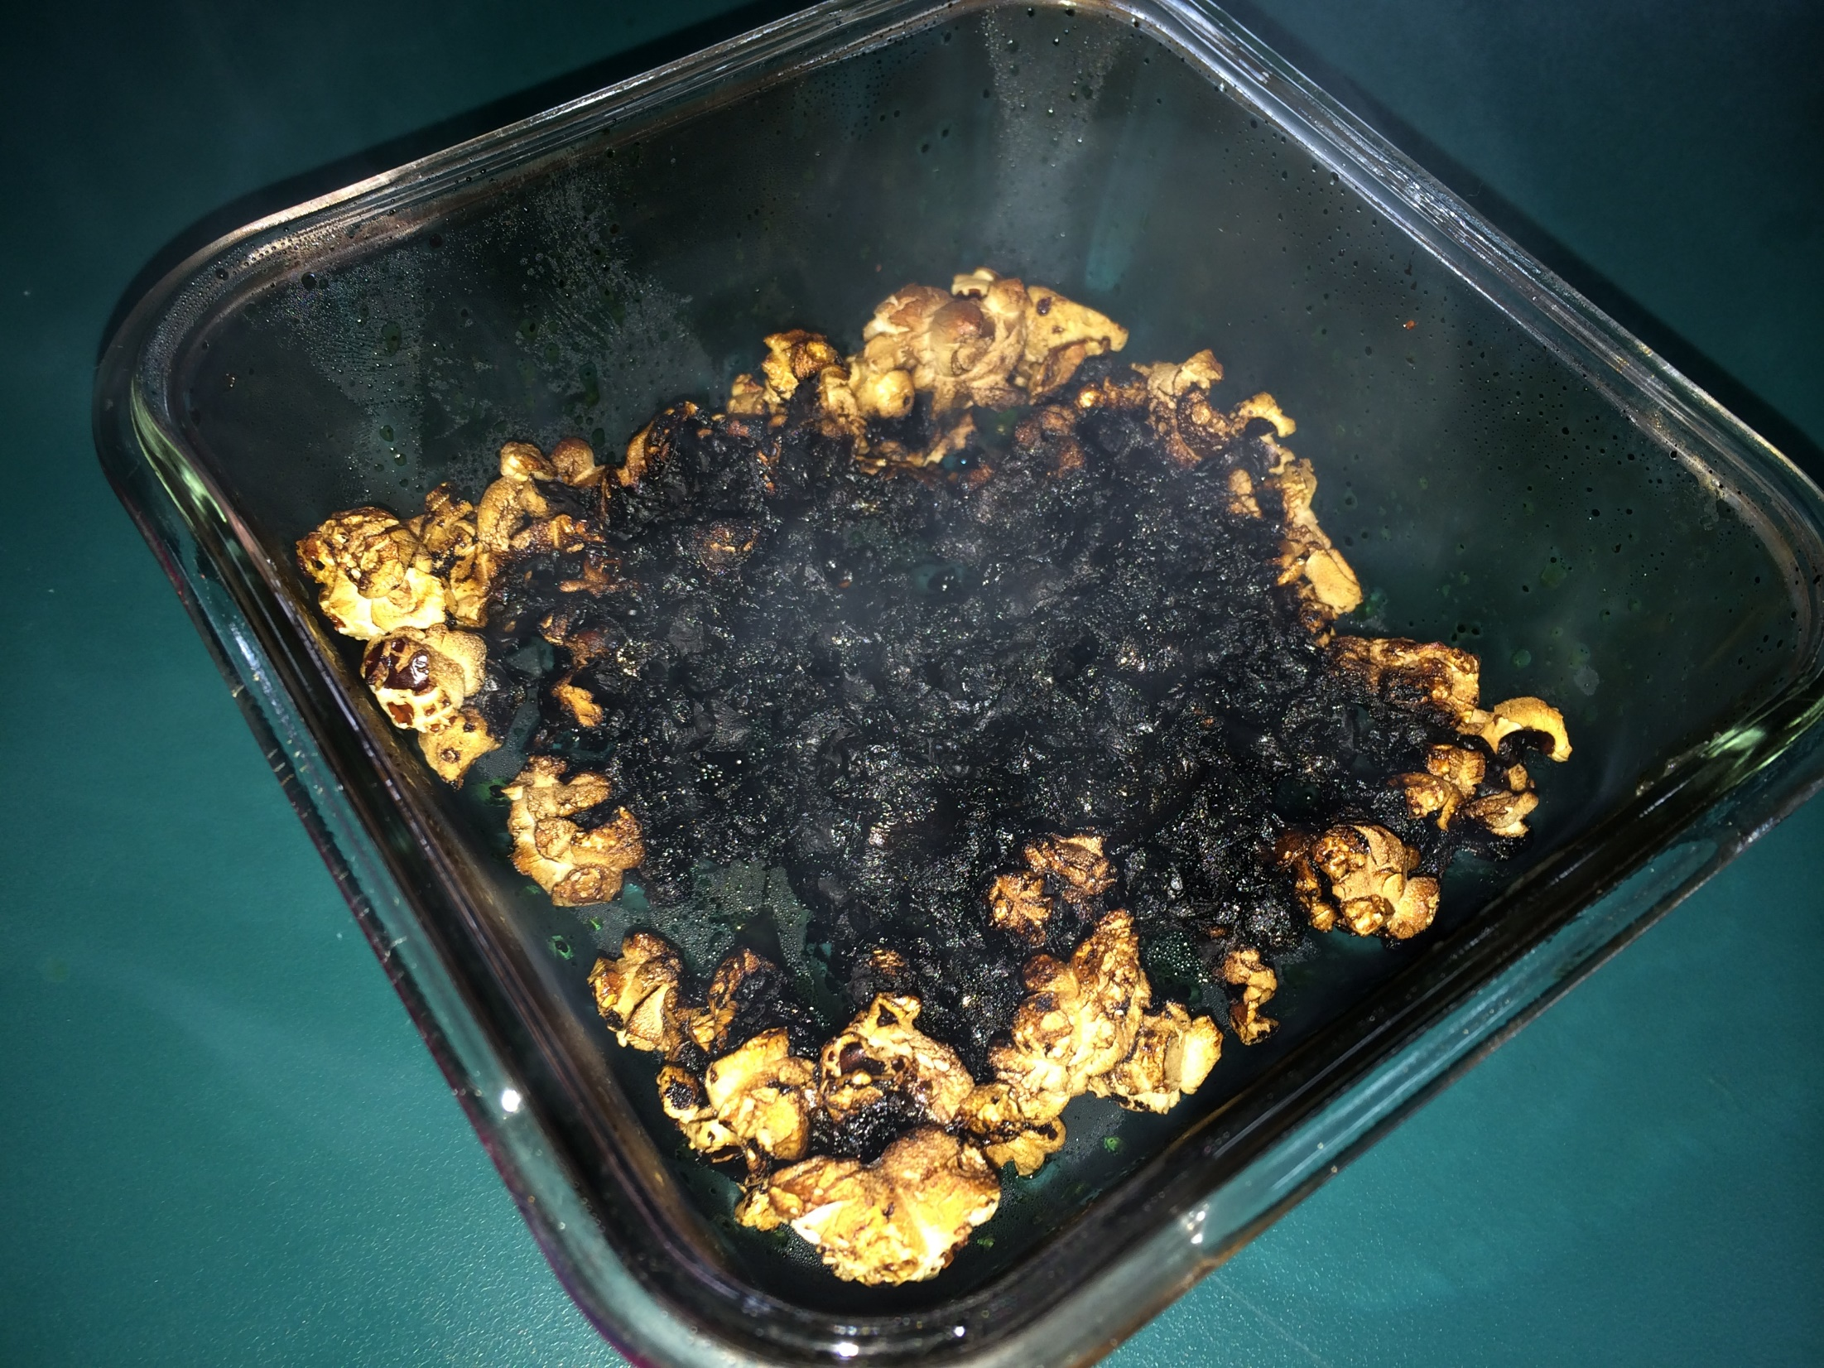

Slide 23
Titbits !

Slide 24
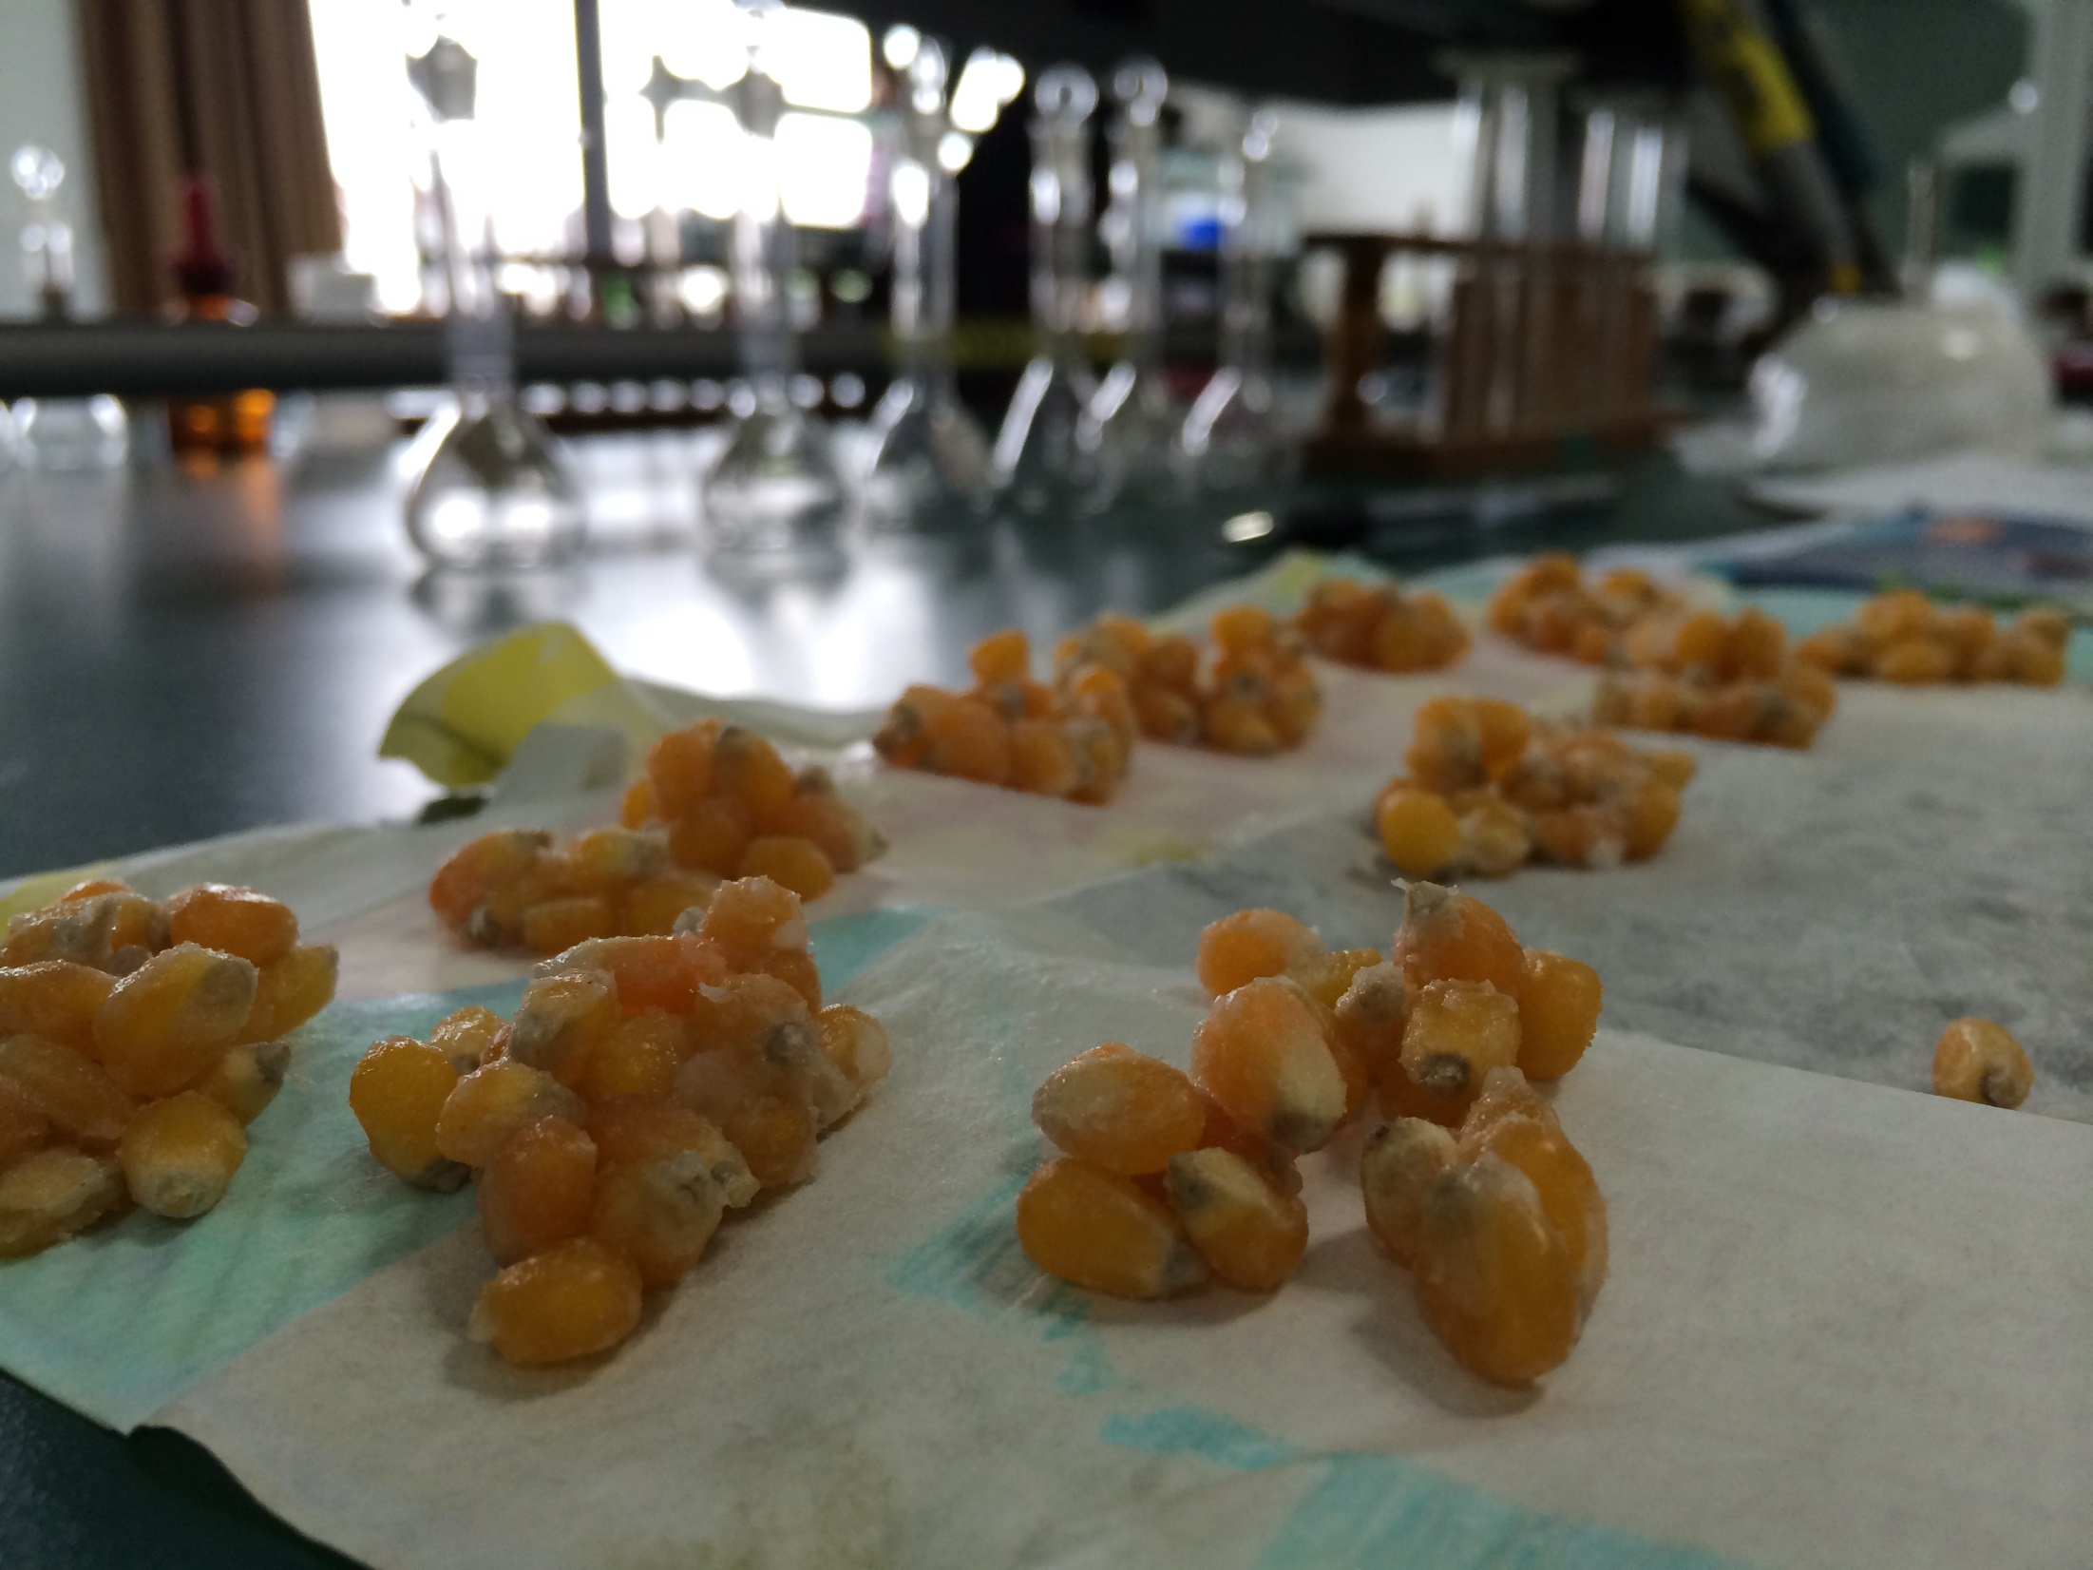

Slide 25
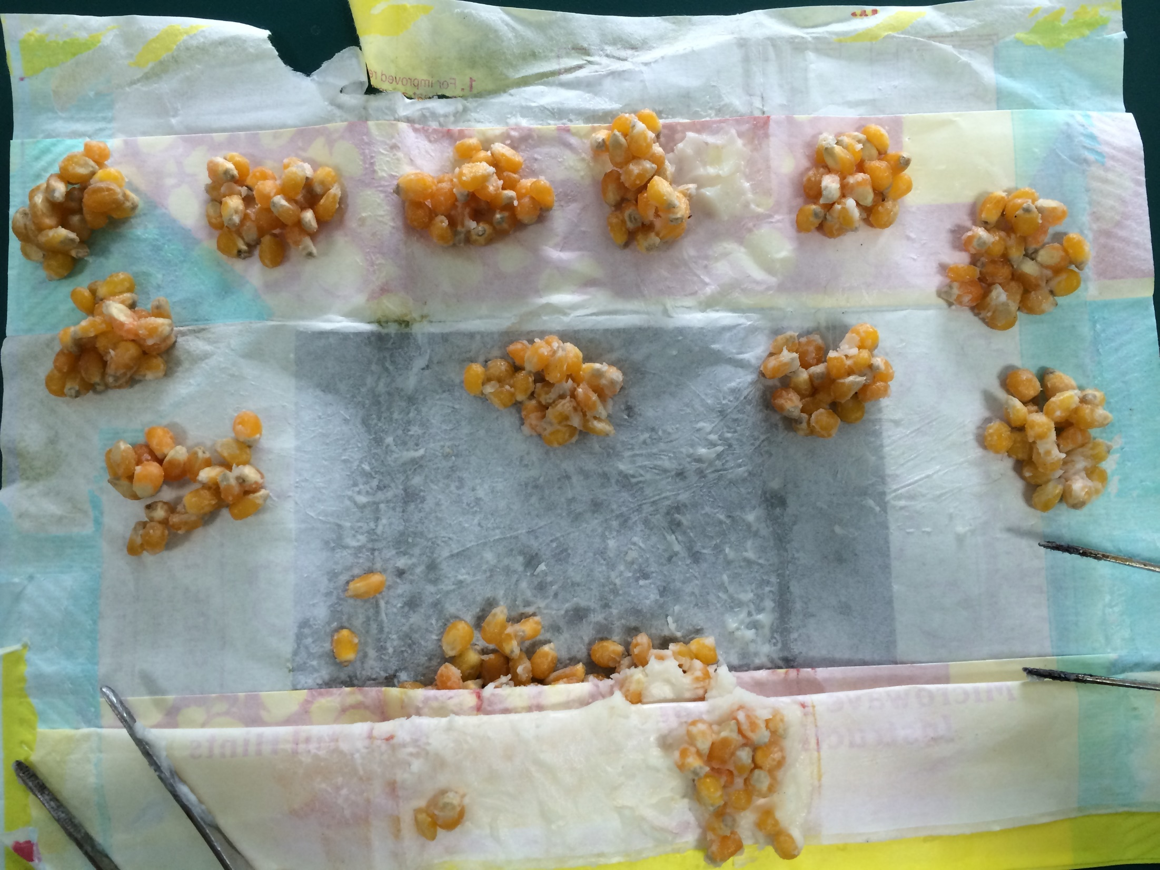

Slide 26
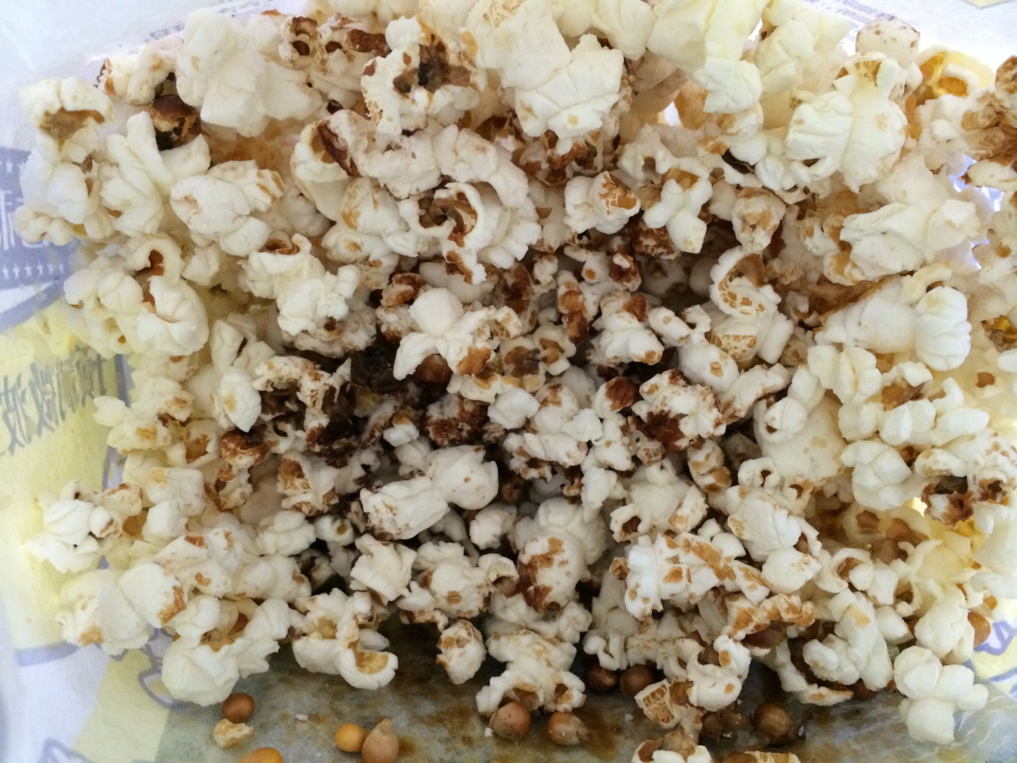

Slide 27
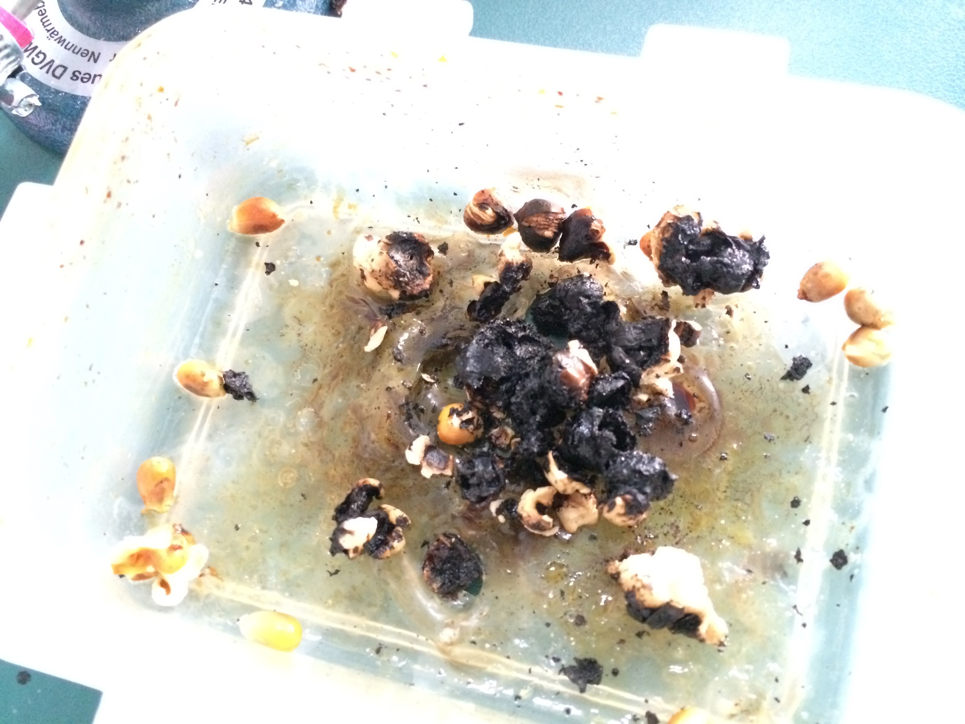

Slide 28
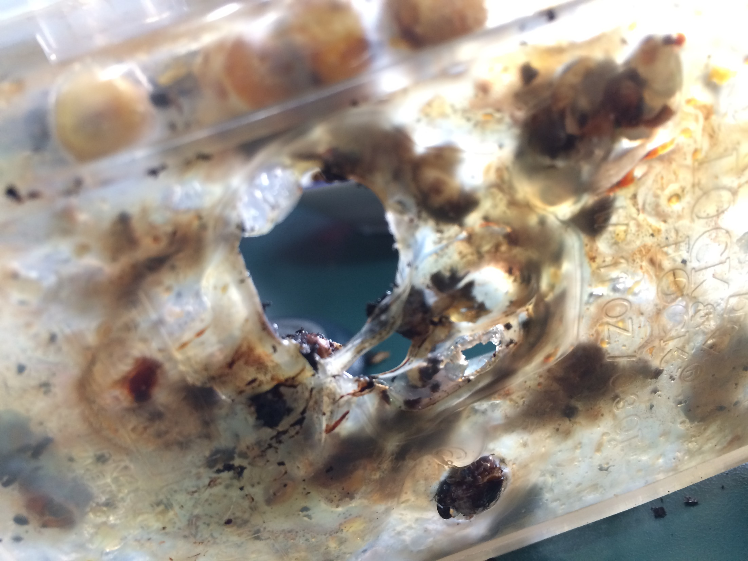

Slide 29
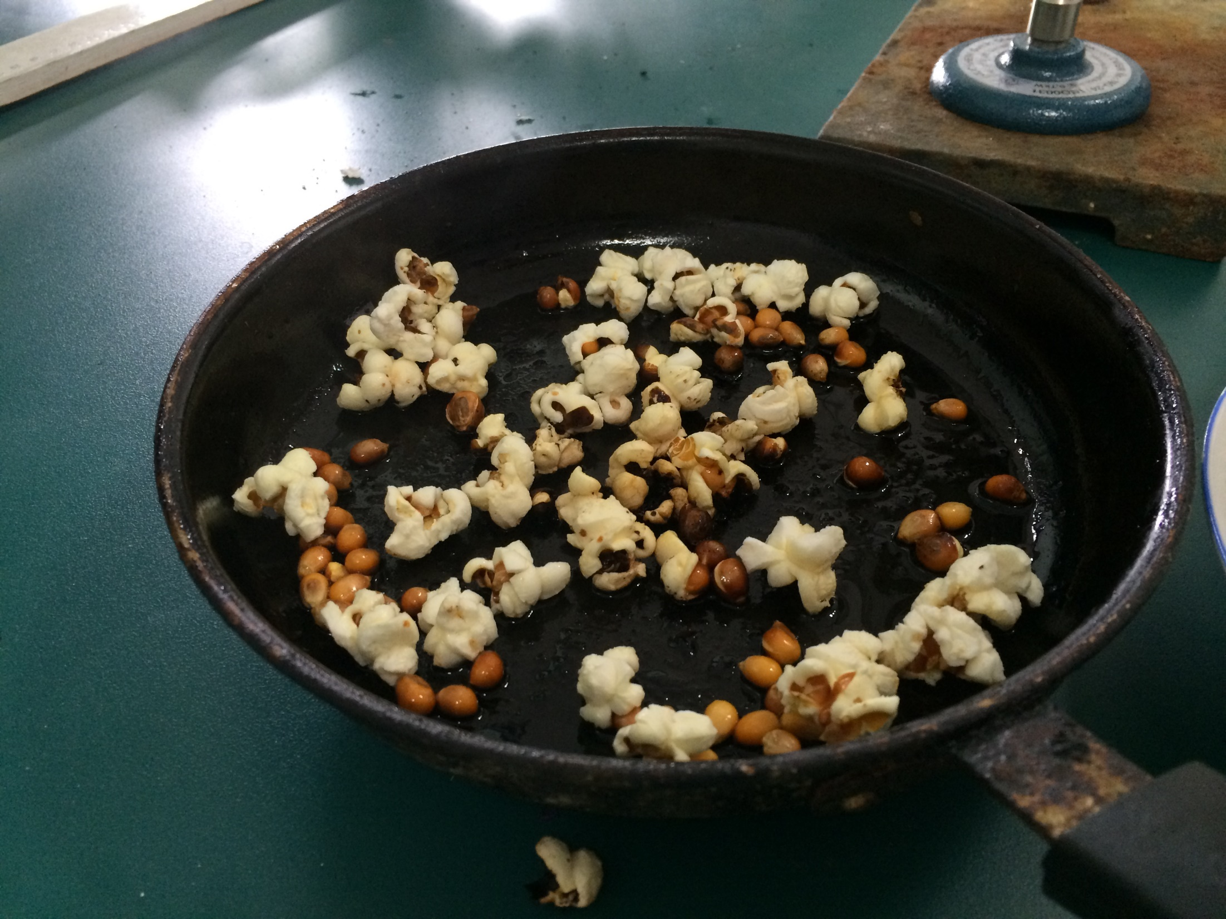

Slide 30
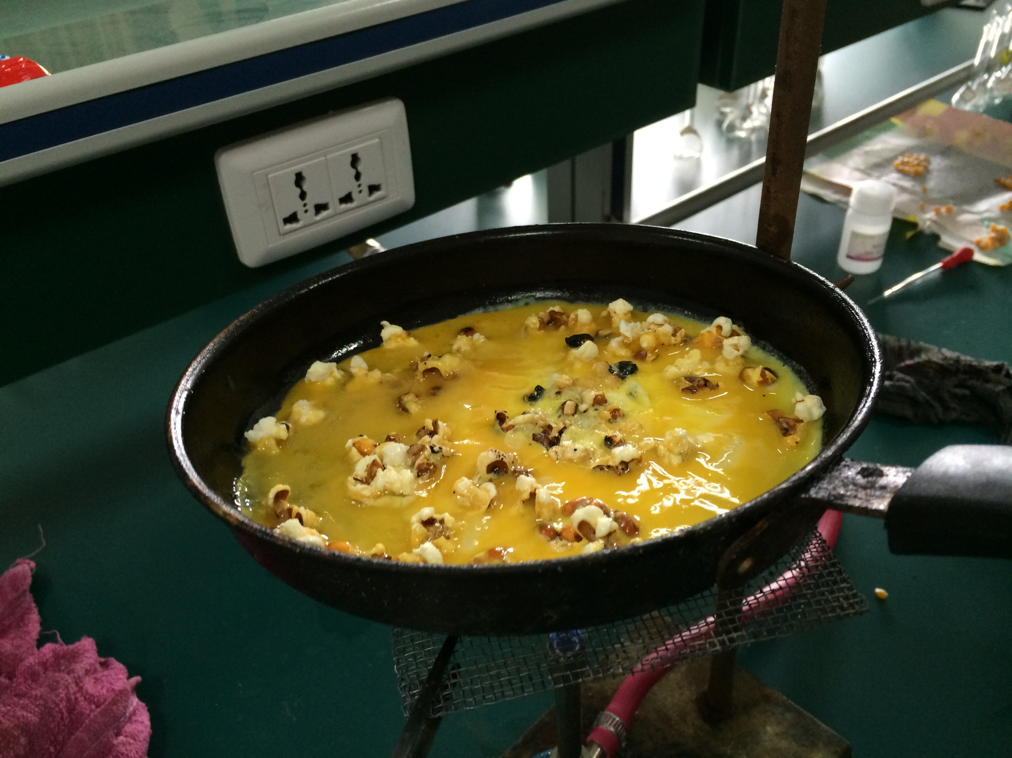

Slide 31
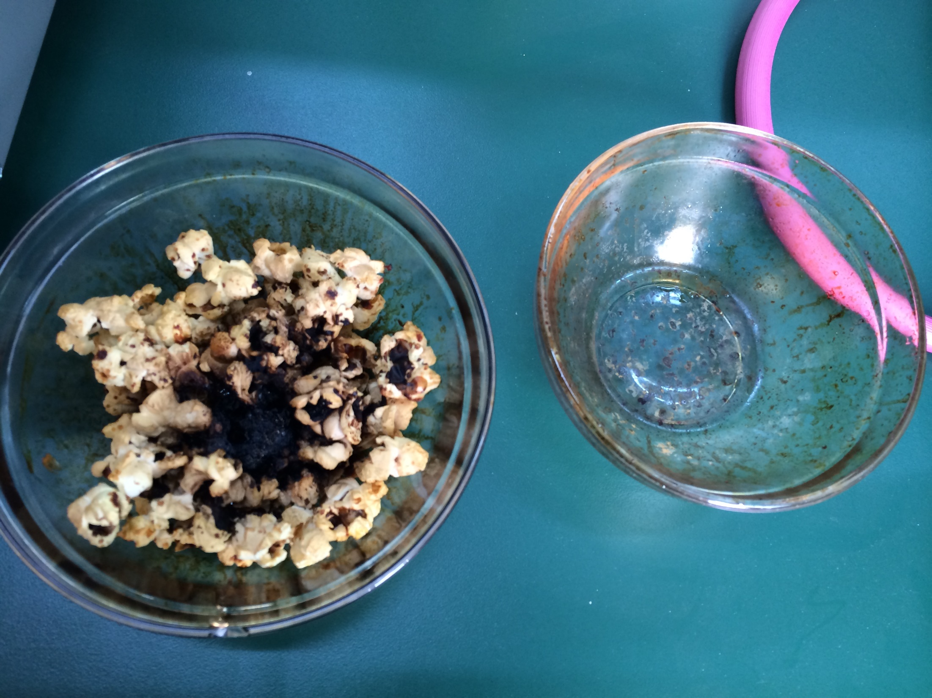

Slide 32
